Slide 1
TIES4560 Demo 2 19.9.2018
Tuukka Jurvakainen
Tuomas Moisio
Erkka Nurmi
Joonas Raja

Slide 2
Task 2.1
A simple servlet based web service that uses IP-address as the paramater to return the country, which the IP-address is located in, and the capital city of that country.

Slide 3
Implementation
The SOAP:s used were
- IP2Geo (gets the IP and returns the country)
- CountryInfo (shows information of the country based on the IP)
Jetty was used to set up the API
The servlet handles the request and calls the SOAP WS Client
The SOAP WS Client is using the IP2Geo and CountryInfo SOAPs

Slide 4
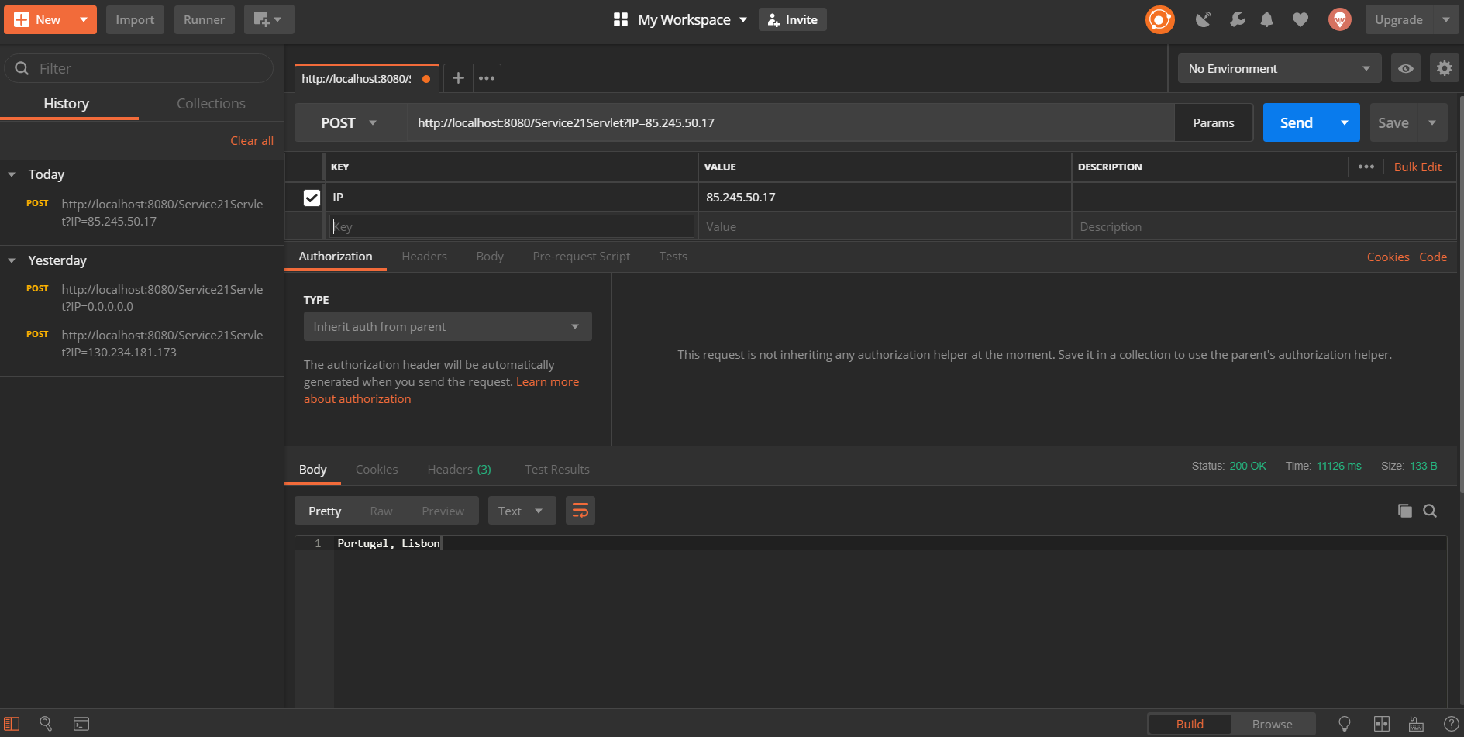
PostMan was used to set up the API Client

Slide 5
Task 2.2
Dropbox web client
Connect to your app in Dropbox via user authentication.
Get information about the user’s account
Upload a file to the folder of your Dropbox app
Get space usage information

Slide 6
Implementation
Java Dynamic Web project using Servlets
Token to authentication
RESTful architectural style
Uses POST and GET calls to communicate with Dropbox
Uses external library to parse JSON data.

Slide 7
